Slide 1

VIBRATO!
It’s time to add some color to those notes!

Slide 2
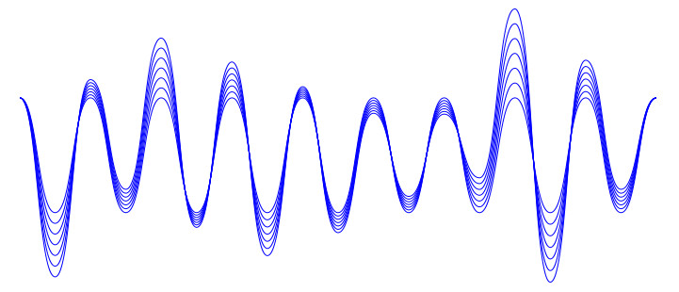
What exactly is vibrato?
Vibrato is a shortening and lengthening of the string,
creating a wave effect in the sound.

Slide 3

Vibrato readiness checklist
Can support instrument without your left hand
Left wrist is consistently straight
Fingers are consistently curved when playing

Slide 4

Vibrato steps
Shake your left hand
Violin/Viola, shake like a bobble head, forward and back
Cello/Bass, shake an invisible can of soda or brush your cheek
Add the tip of your left thumb (Violin/Viola, slide thumb under the neck so fingers are up and over.)
Add your 2nd finger, letting it roll in the same direction as the string
Only add steps if the previous ones are comfortable.
Go right from one step to the next without stopping.

Slide 5
Vibrato checklist
The side of the hand does NOT TOUCH
(Only two points of contact: thumb and fingertip)
Base of the thumb is a LOOSE pivot
Barely touch the top of the string, no pressing
End knuckle should be free to flex
Violin/Viola roll from tall to flat and back
Cello/Bass roll side-to-side or diagonally across finger

Slide 6
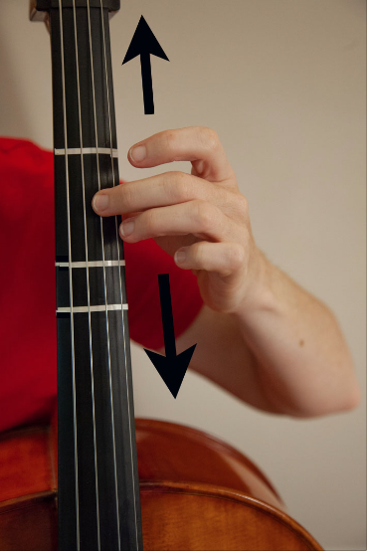
Slide-n-stick method
Slide up and down your string as though you were polishing it with 2nd finger.
Slides get smaller and smaller
Keep the forward/backward motion going, but let the finger stick in place.

Slide 7

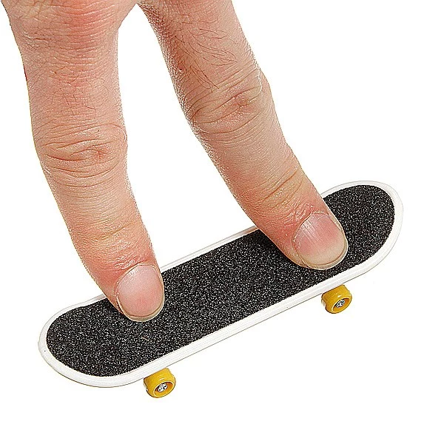
Vibrato Aids
Tic-Tacs- use a small shaker to get the hang of a steady shake
Skateboard- use a finger skateboard to get used to moving in line with your strings.

Slide 8


Need more help? Here’s a video:
https://youtu.be/aQCH-jHydEg
Practice lots, play pretty!

