Slide 1
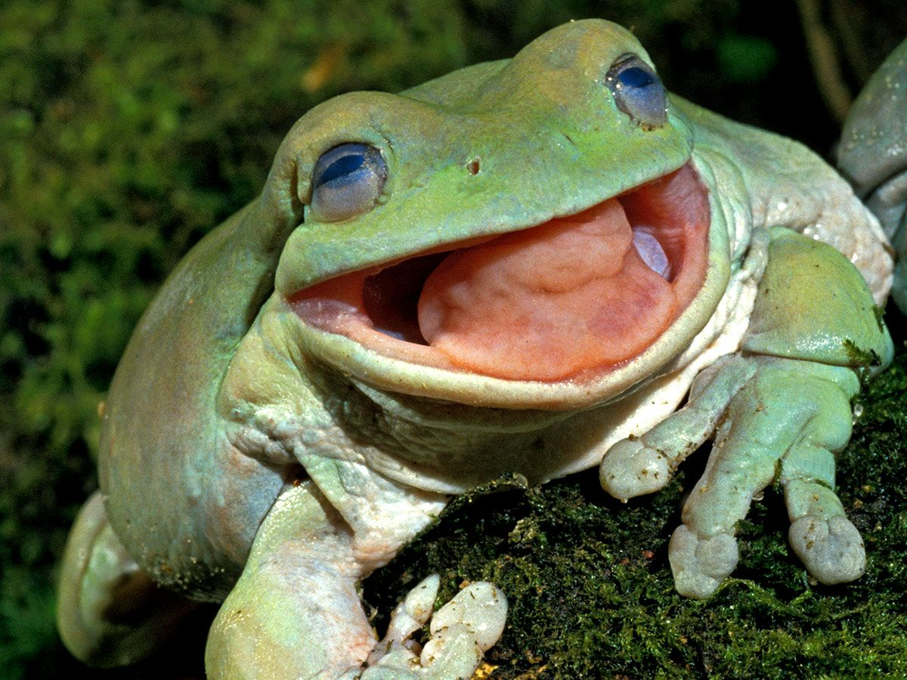
Frog Awareness Day!!

Slide 2
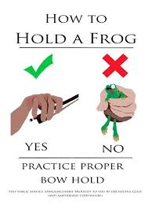

Slide 3

Don’t avoid your frog!

Slide 4
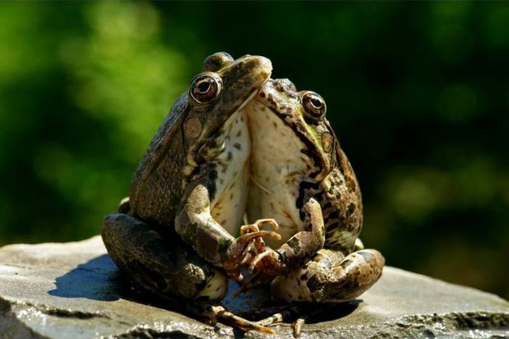
Embrace
your frog!

Slide 5
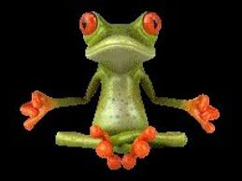
Be one with
your frog!

Slide 6
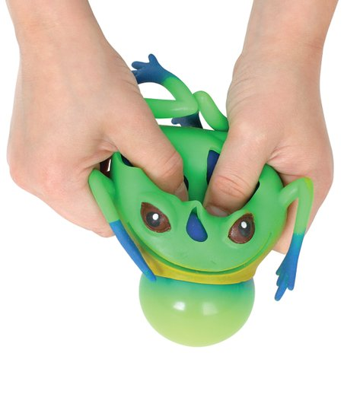
Don’t squeeze your frog!

Slide 7
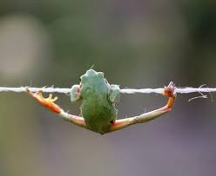
HANG
on the frog.

Slide 8
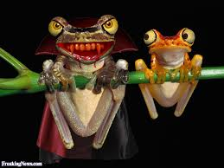
Don’t be
afraid of
your frog!

Slide 9
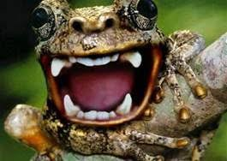
But DO
use your frog
to “bite” the string!

Slide 10

Your frog gives you POWER!!!!

