Slide 1

Bow Hold Drill
Know it. Drill it. Do it!
HANG the back of your fingers on top of the frog. (Elbow out!)
ROLL fingers toward the left
SET THE PINKY: Violin/Viola: on top of the stick, curved and close Cello/Bass: against the side of the frog, curved, not collapsed
SET THE THUMB:The corner of the tip of the thumb goes on the stick next to the frog. Not in it or under it!!
ALMOST LET GO! Relax! That’s an order!

Slide 2
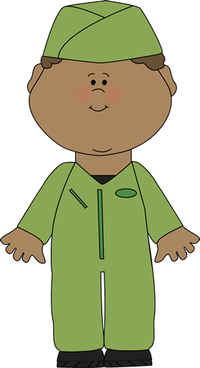
Checklist
Check it!
Middle fingers flat against the frog
Elbow out
Fingers leaning to the left
All fingers curved
Natural spacing, not too close or too wide
Thumb tip points up at the stick next to the frog
Thumb BUMPED OUT!
Pinky curved, on top for violin/viola, on side for cello/bass
Soft, loose, flexible fingers

Slide 3
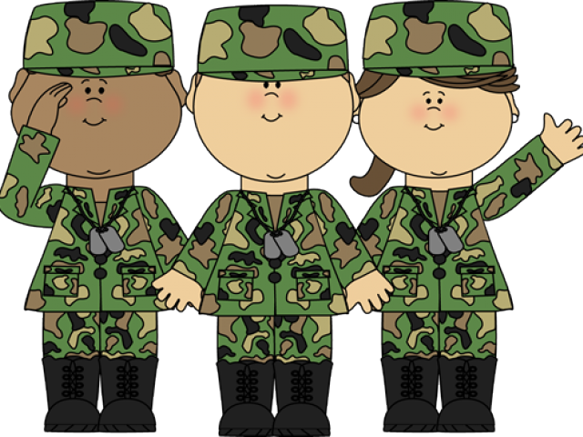
Activities
Do it!
Run the drill!
Practice with a straw to be sure you’re not squeezing
Put it down, pick it up. How quickly can you make a good bow hold?
Finger taps
Wave, windshield wipers, paint brush, rocket ship, etc.
Use rubber band and pinky cup (violin/viola)
Cello/bass, try sliding your hand toward the tip for balance
Open/close from the elbow

